Slide 1






Mentorship program
HR ANALYTICS
DASHBOARDS
Khuat Bao Nguyen

Slide 2



Agenda
01
02
Brainstorm
Dashboards
Mentorship program

Slide 3
Brainstorm
1
Identify Roles and Dashboards
2
Identify detailed data of each Dashboard
3
Redesign Dim and Fact Tables

Slide 4
Identify Roles and Dashboards

Slide 5
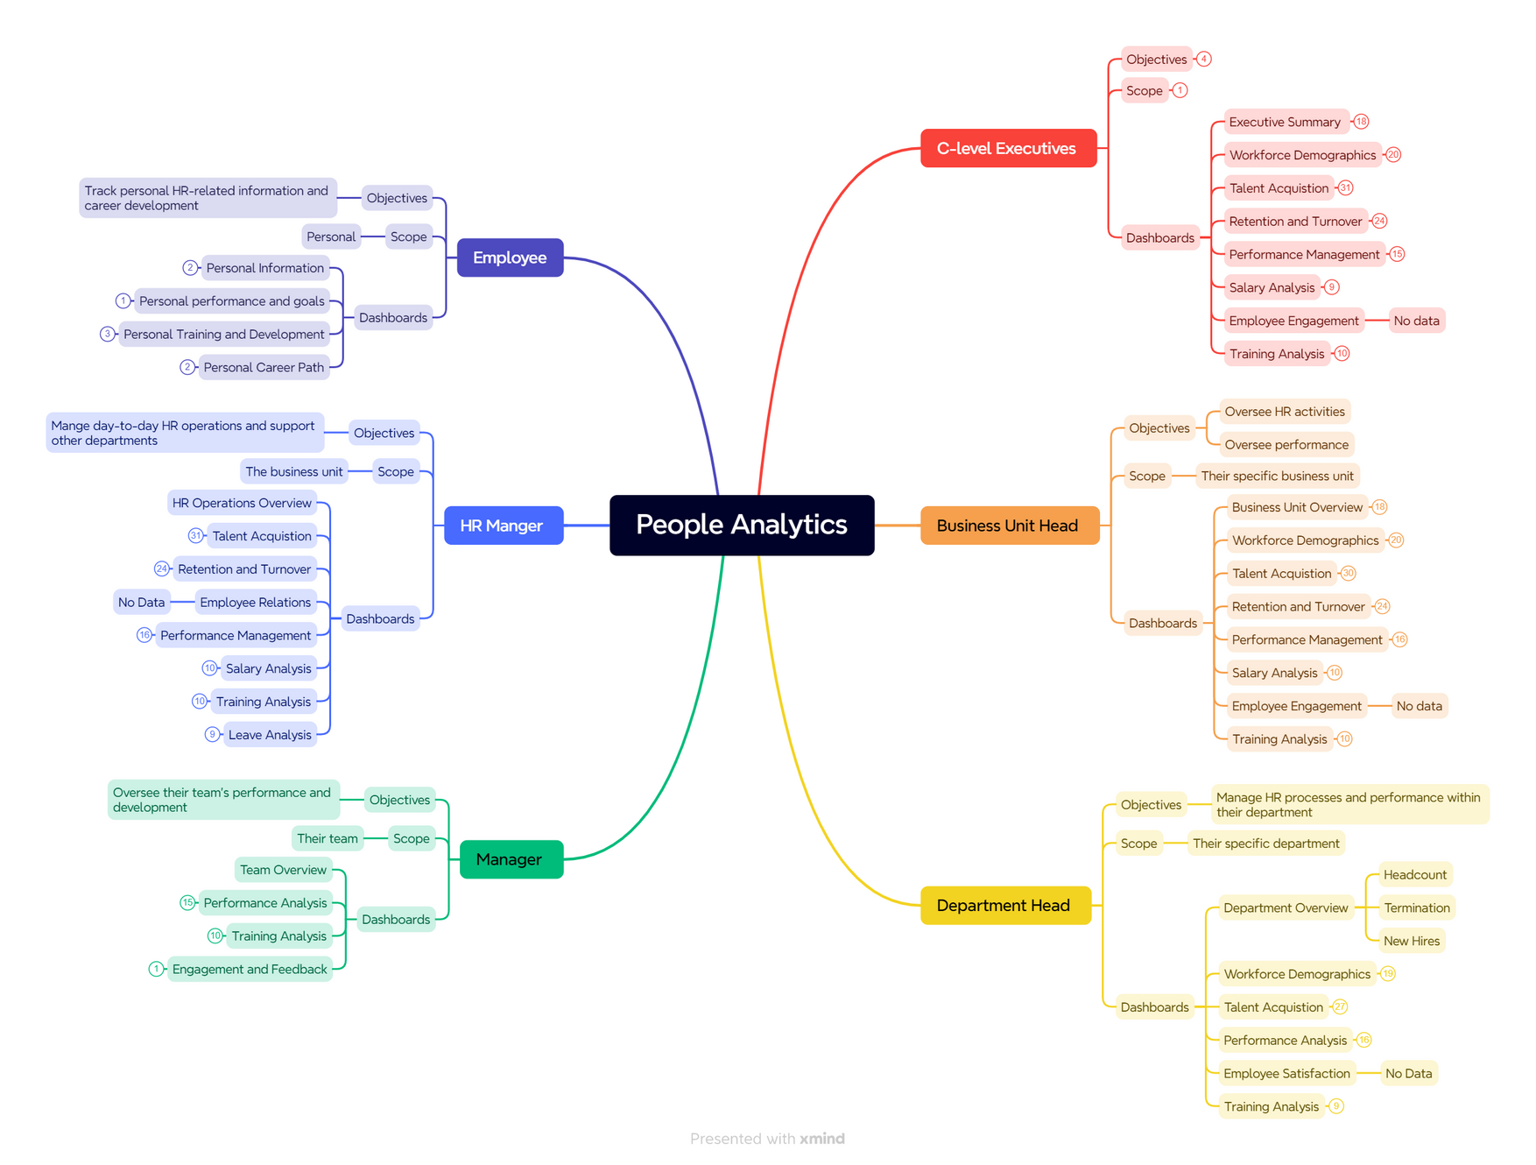

Slide 6
Identify detailed data of each Dashboard

Slide 7
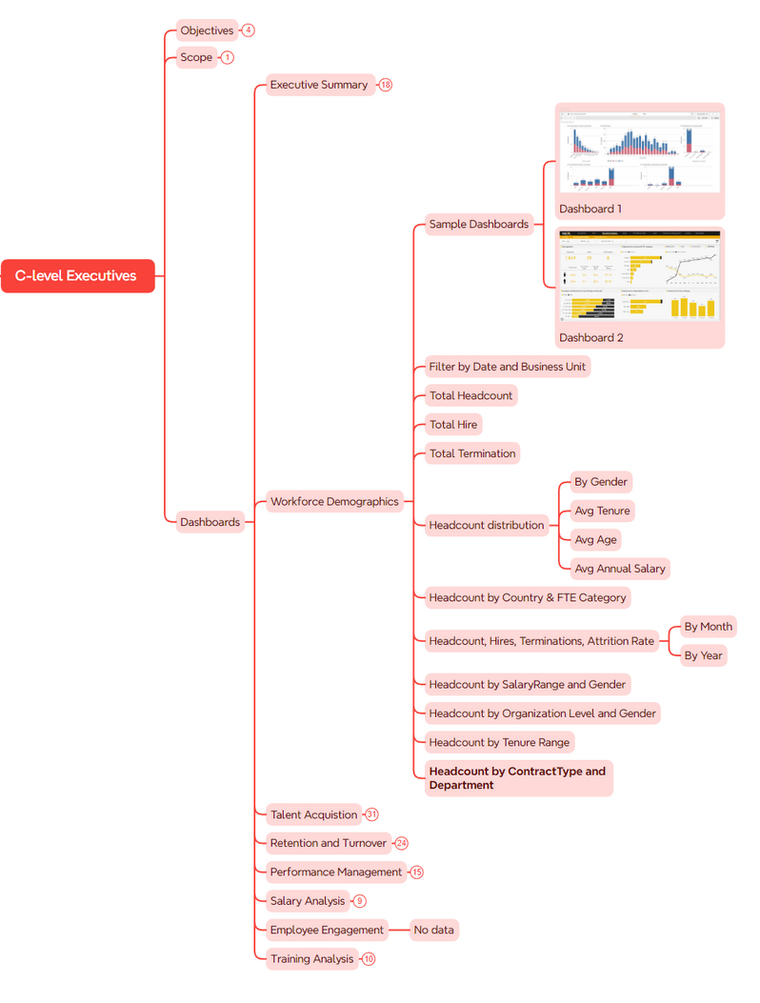
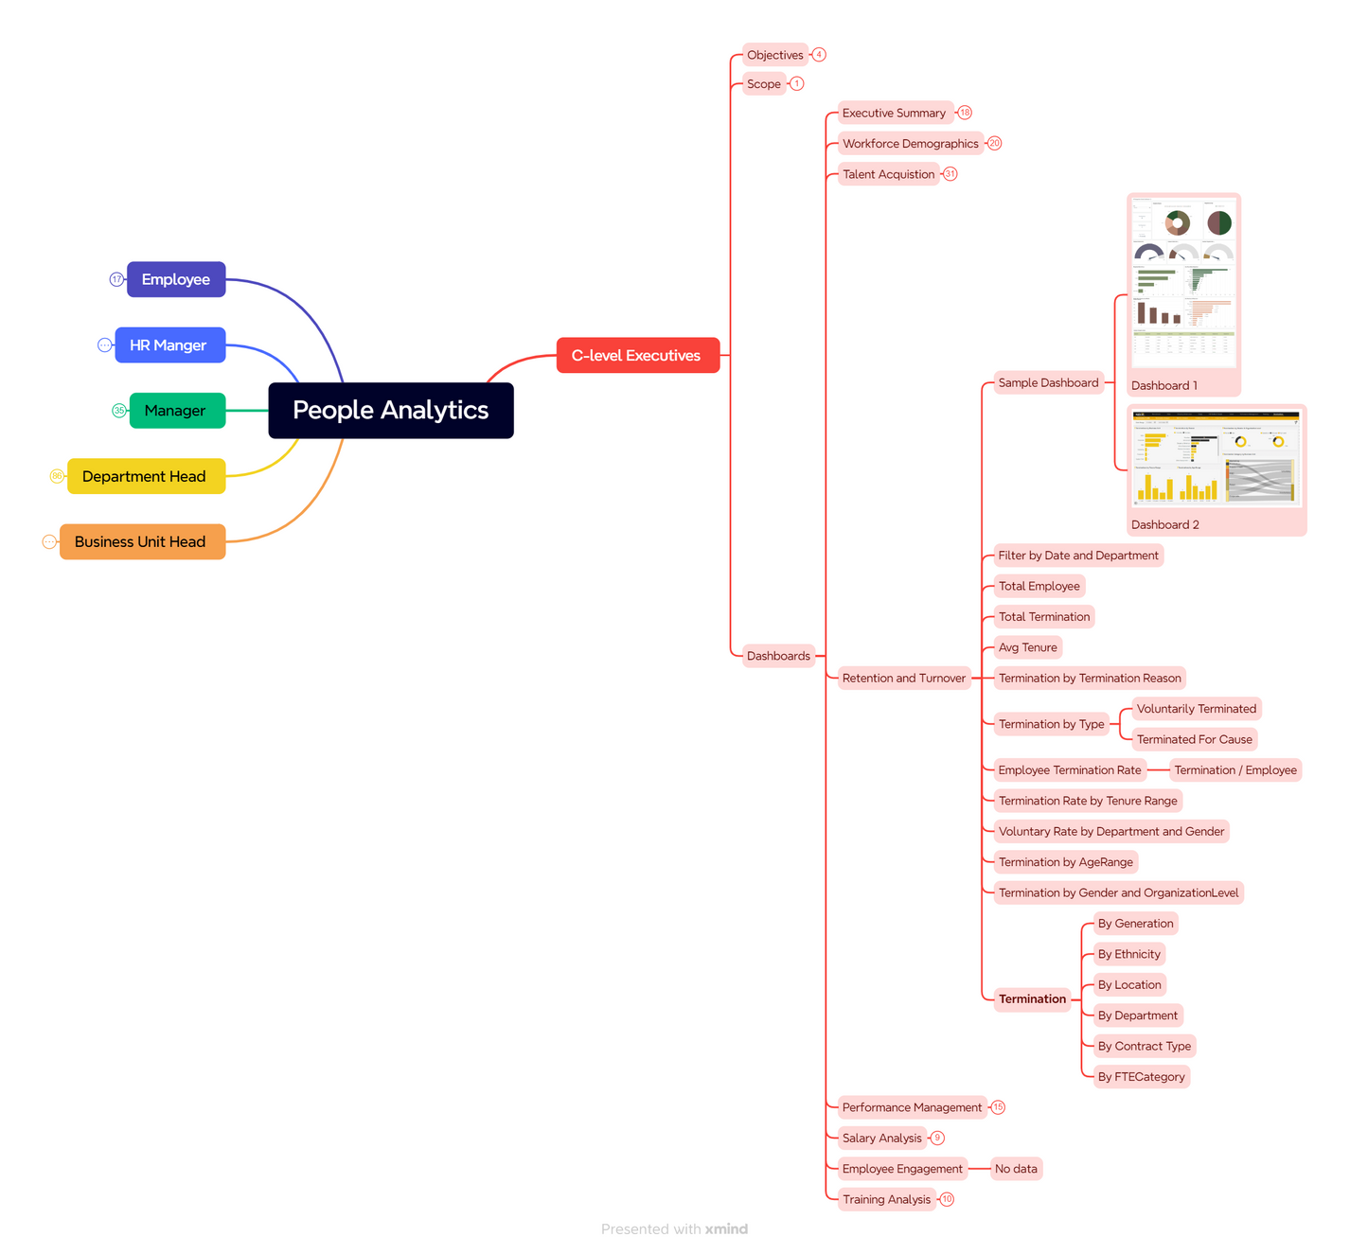
Brainstorm for all dashboards: https://bit.ly/3xaregZ

Slide 8
Redesign Dim and Fact Tables

Slide 9
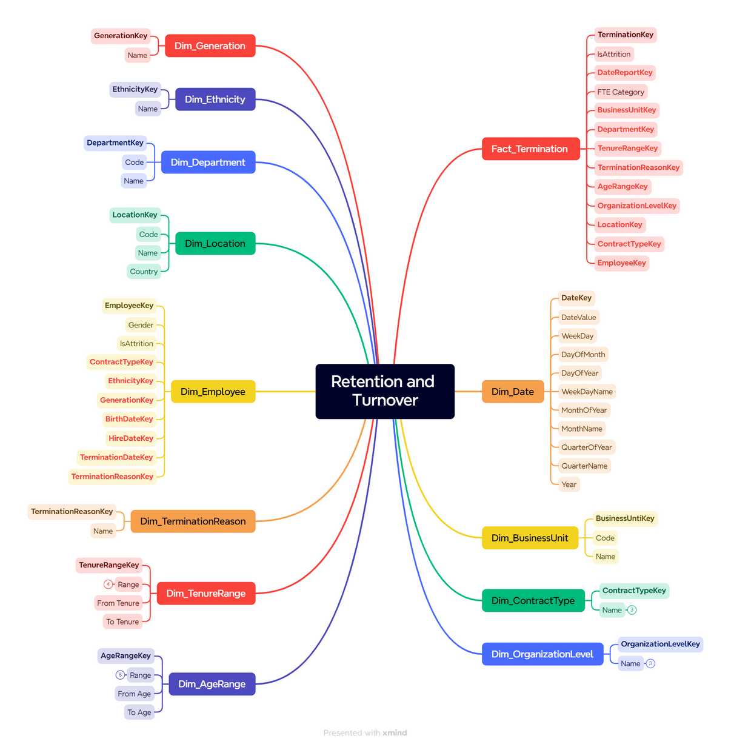
Retention and Turnover

Slide 10
Dashboards
1
Transform data
2
Design Dashboards in Power BI

Slide 11
Transform Data

Slide 12
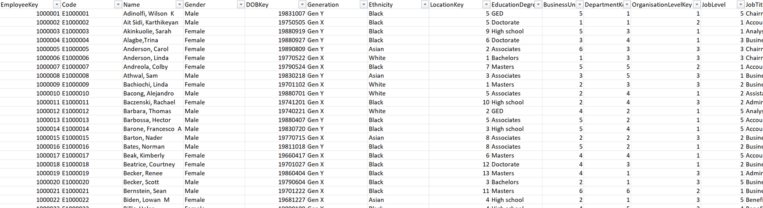

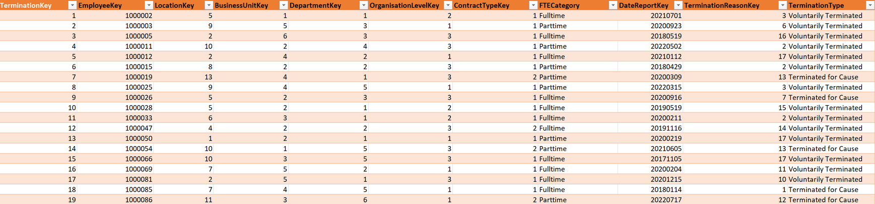
Retention and Turnover

Slide 13
Design Dashboards in
Power Bi

Slide 14
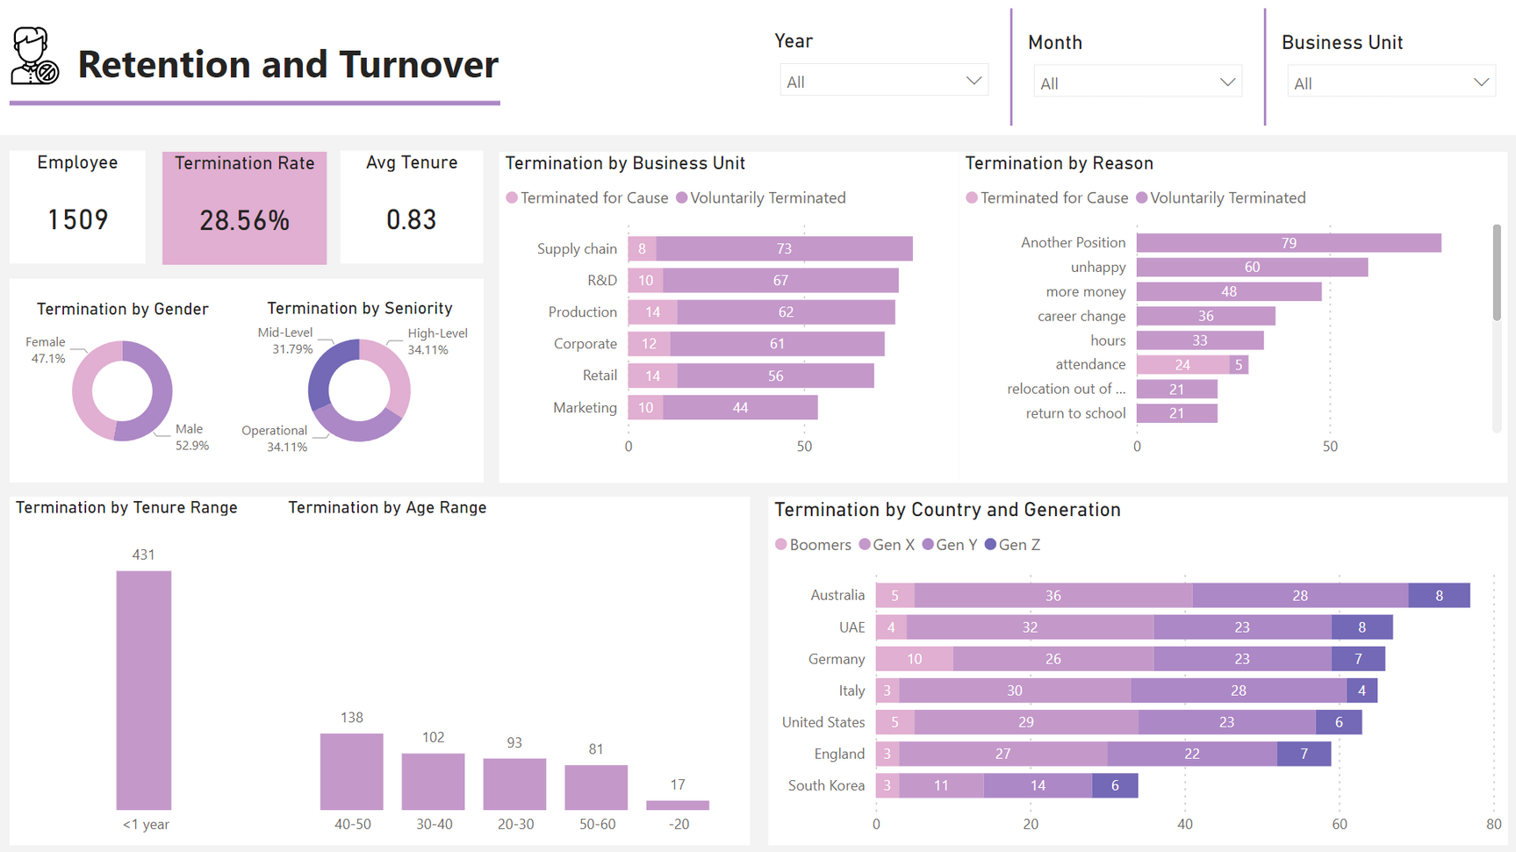
Retention and Turnover

Slide 15


Thank you
I really appreciate your time.
Khuat Bao Nguyen

